Slide 1
From the Ground Up Building in Accessibility at the Wireframe Stage
Mona Rekhi & Derek Featherstone
CSUN 2018 Assistive Technology Conference
March 23, 2018

Slide 2
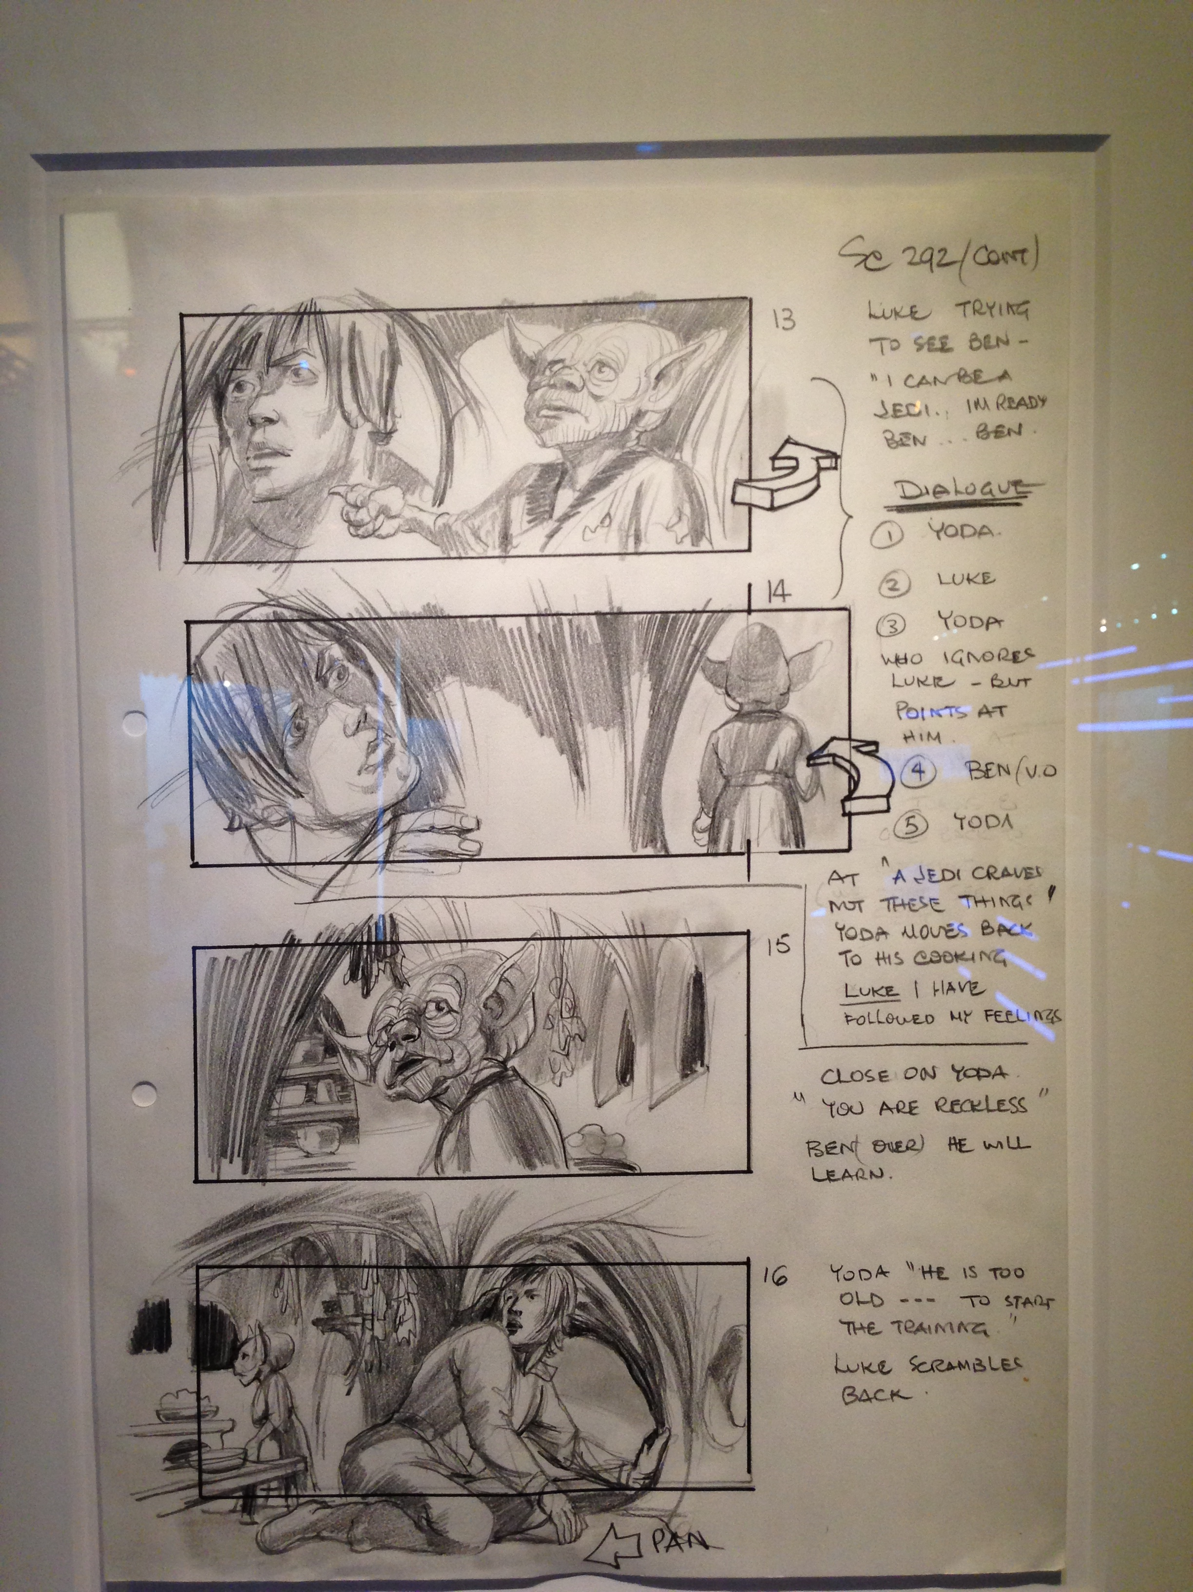
Star Wars: Storyboards as wireframes
Notes:
- Wireframe sketch from Star Wars

Slide 3
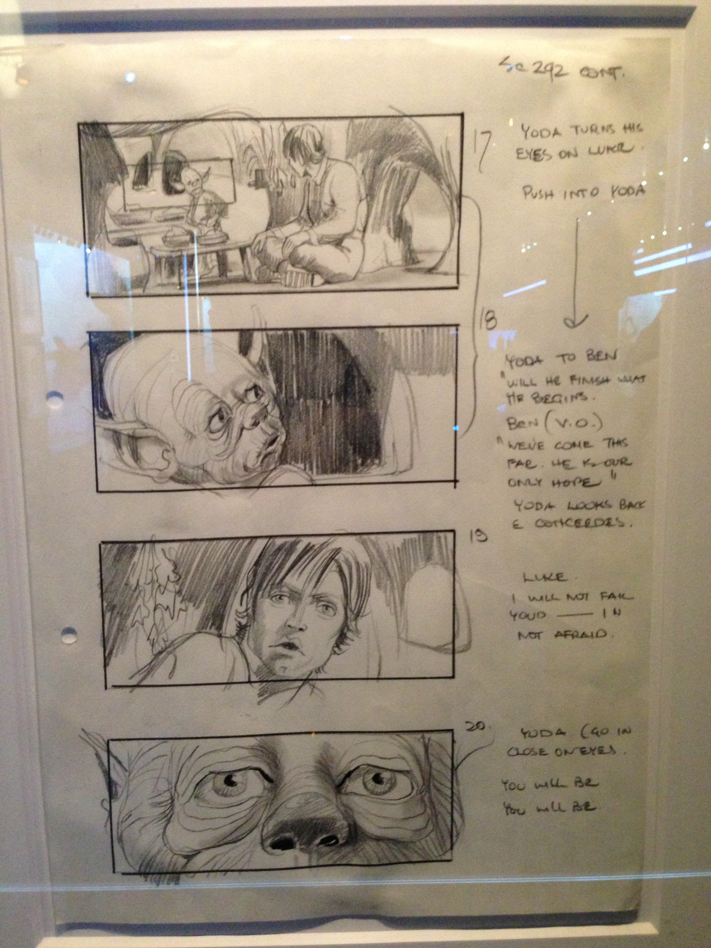
Star Wars: Storyboards as wireframes

Slide 4
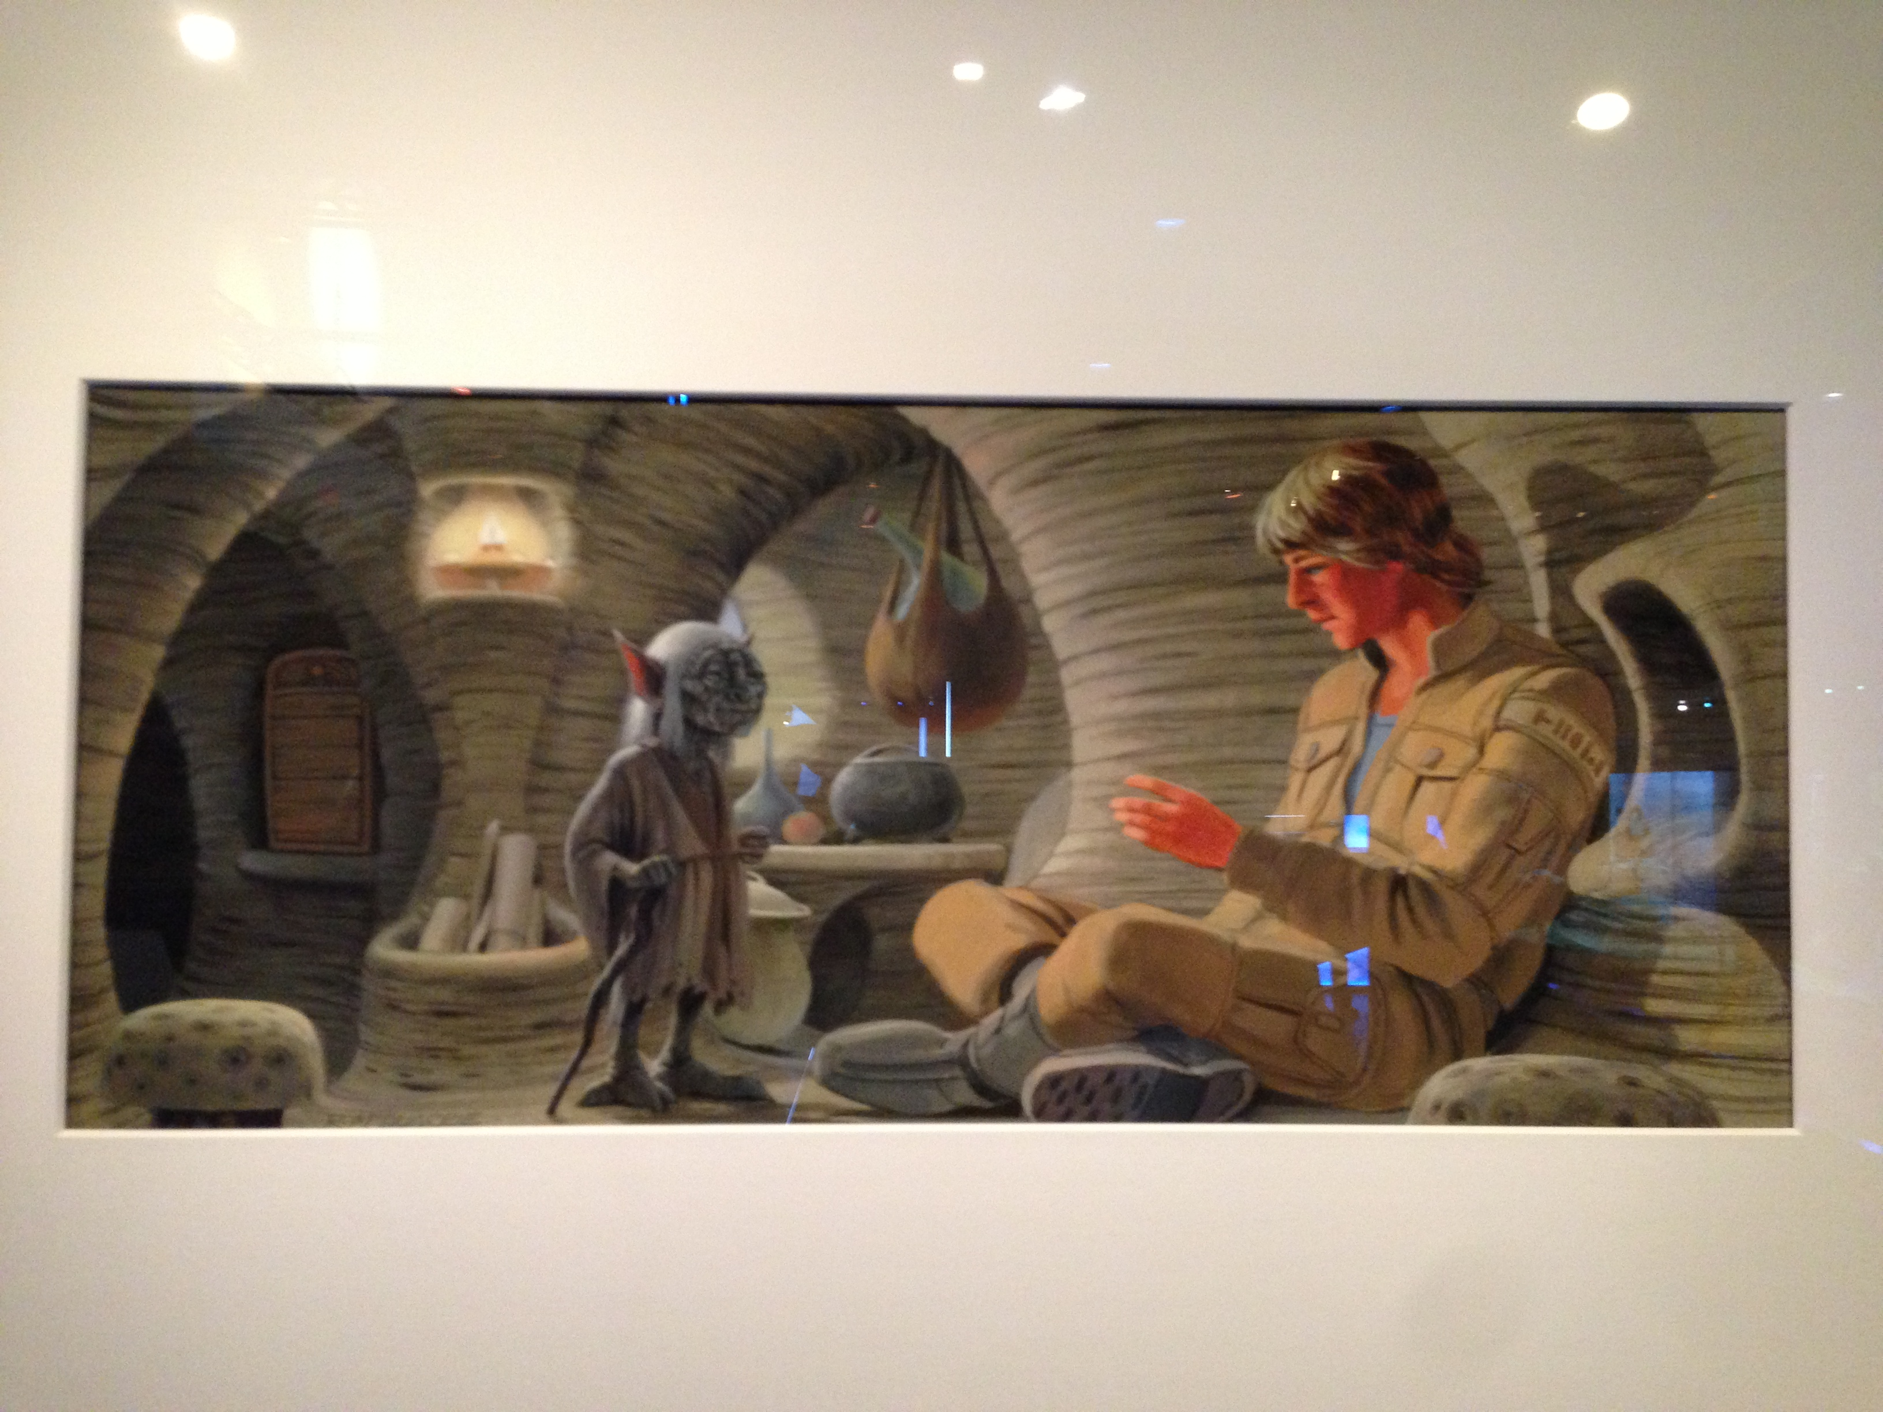
Star Wars: Concept art as mockups
Notes:
Concept art – based on wireframe sketches

Slide 5
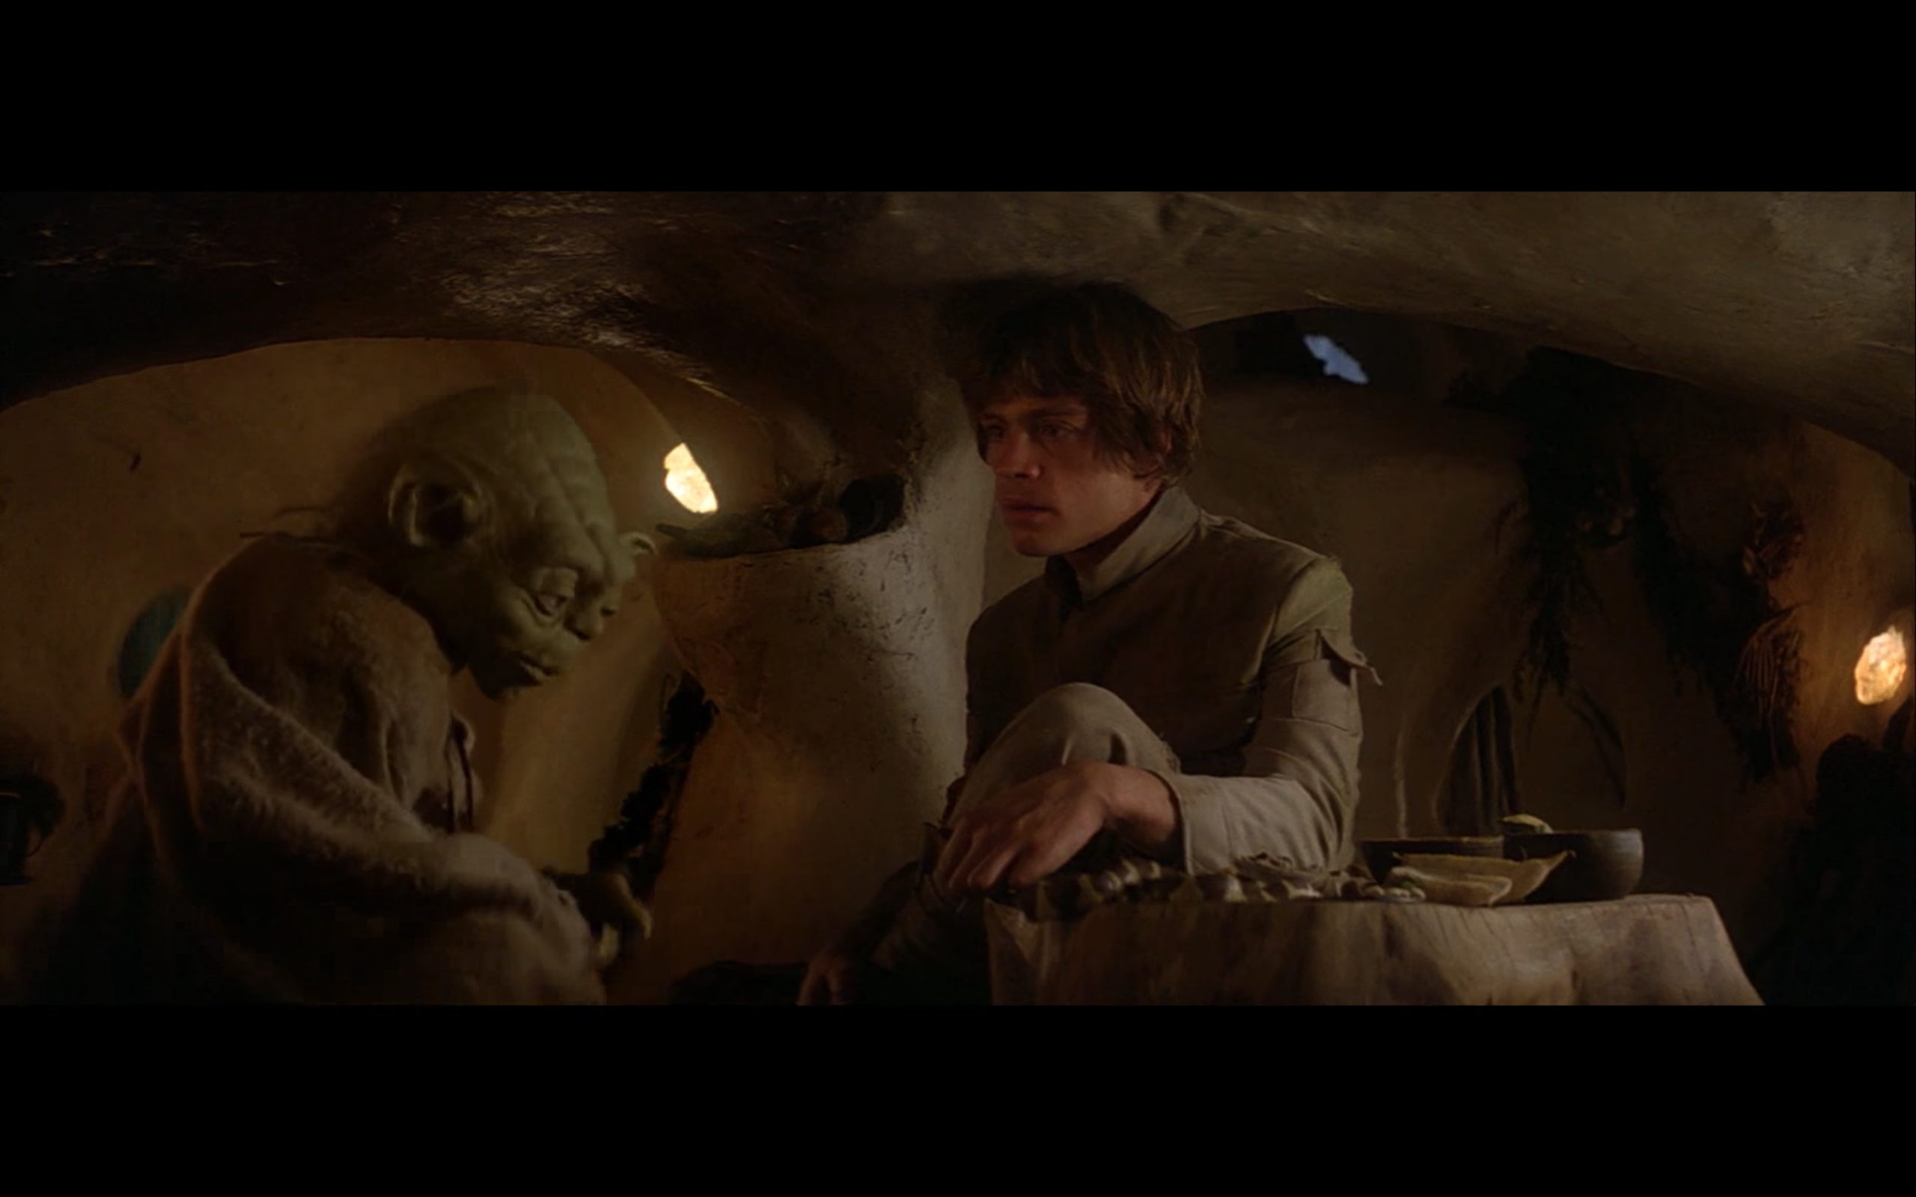
Star Wars: The final version as production web site
Notes:
Insert actual scene from Star Wars – Luke and Yoda sitting in hut… highest quality available.
Wireframes serve many purposes
get ideas out there, and test them… will this work?
Provide direction for the rest of the team
Set the course for production of the next and final iterations

Slide 6
Wireframes: elearning course
Notes:
Wireframe view of video player as part of an e-learning course. We were asked to come in very late in the game... nearing the final product to do an accessibility review.
Sadly, it was way too late.

Slide 7
Cost of accessibility at different stages of a project
$60,000
10X
$25,000
$10,000
Accessible templates
Start over half way through
Last minute emergency Create separate accessible version
Notes:
We assessed what was there, let them know the changes that the courses and the framework would need in order to be accessible.
It was going to cost roughly $90,000 to fix what was there and undo the mess (it was really messy!)
What if we look at that same problem at scale? We’re talking some really serious cost

Slide 8
Cost of accessibility at different stages of a project
$600,000
$250,000
$100,000
Accessible templates
Start over half way through
Last minute emergency Create separate accessible version

Slide 9
Estimates of relative cost of re-work
https://konceptapp.com/blog/2015/12/03/how-much-would-you-pay-to-save-a-product-with-bad-ux/
Notes:
Graphic from a blog post “How much would you pay to save a product with bad UX?”
The source of the data was Forrester Research. Title is: “Estimates of relative cost of re-work” and shows 5 columns. This is a relative comparison of X where X is a normalized unit of cost and can be expressed in terms of person-hours, dollars, etc. Relative costs are listed as follows:
Design and architecture stage: 1X
Implementation: 5X
Integration test: 10X
Customer beta test: 15X
Post product release: 30X

Slide 10
Idea to launch
Number of design
alternatives
Cost to change
your mind
IDEA
LAUNCH
Notes:
As we proceed from idea to launch of anything, the number of design alternatives decreases. We end up with 1 design as we get close to launch. The cost to change our minds all the way along increases… the best spot to change your mind is in the first part of the timeline.

Slide 11
From the Ground Up Building in Accessibility at the Wireframe Stage
Mona Rekhi & Derek Featherstone
March 23, 2018 CSUN 2018 Assistive Technology Conference
Notes:
THIS is the reason we like talking about doing things at the wireframe stage… it costs less to change our mind… it helps prevent costly rework, we ideate to try ideas out

Slide 12
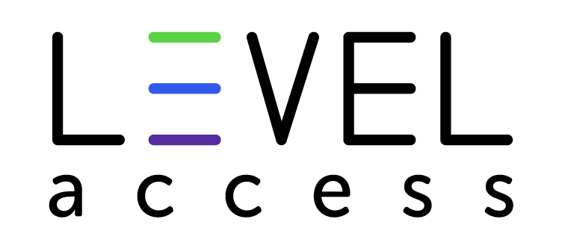
Level Access

Slide 13
Business strategic priorities
Business Strategic Priorities
Increase revenue
Decrease costs
Increase new business
Increase existing business
Increase shareholder value
Jared Spool, UIE
Notes:
As an industry, we’re good at dealing with the technical side of things, but we’re not nearly as good at dealing with the design side of things. We get perfect technical execution on designs that aren’t accessible and easy to use. We need to convince executives to invest in doing accessiblity in the design stage.
One of the ways we can do this? Really drive home the message that doing so DECREASES COSTS. And, if we end up creating better products because of it, we end up increasing revenue, new business, and increase existing business. It’s a great driver…

Slide 14
Why we review wireframes
We review wireframes because of their predictive and preventive value.

Slide 15
Why we review wireframes
Wireframes are great conversation starters.

Slide 16

THINGS THAT DECREASE COSTS

Slide 17
This slide intentionally left blank

Slide 18
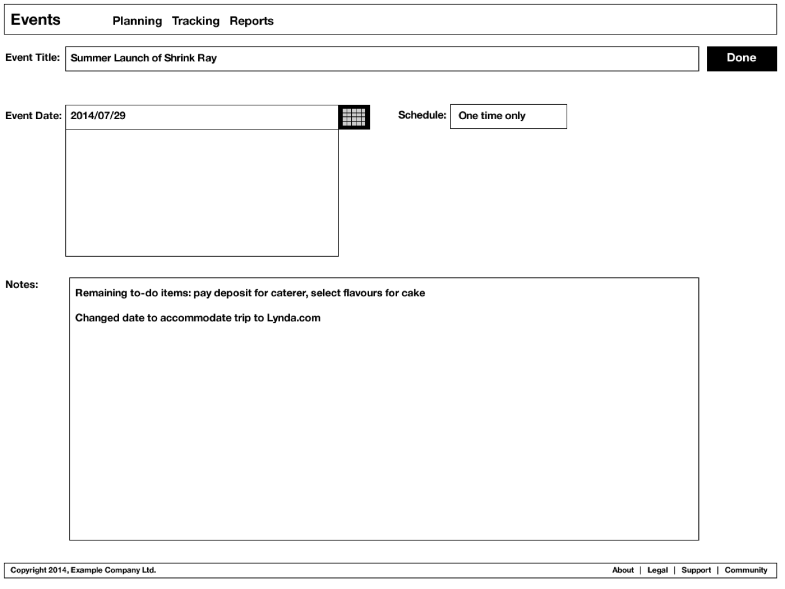
Wireframes: events interface
Notes:
Do the straw test – possibly include my regular straw test example.

Slide 19
Proximity issues
Notes:
Proximity – the little things along the right side – we’ve seen in usability studies that these things being far off to the right can cause lots of issues… they’re easily missed. What would it take to change this design after it has already been approved/signed off by “higher ups”? A lot more than you think. You spend money, yes, but you also spend political capital, and make accessibility the villain “We need to change this because of accessibility, and yes, I know you already signed off on it, but can you go and convince all the stakeholders we need to do this?”

Slide 20
THINGS THAT MAKE OUR PRODUCT BETTER

Slide 21
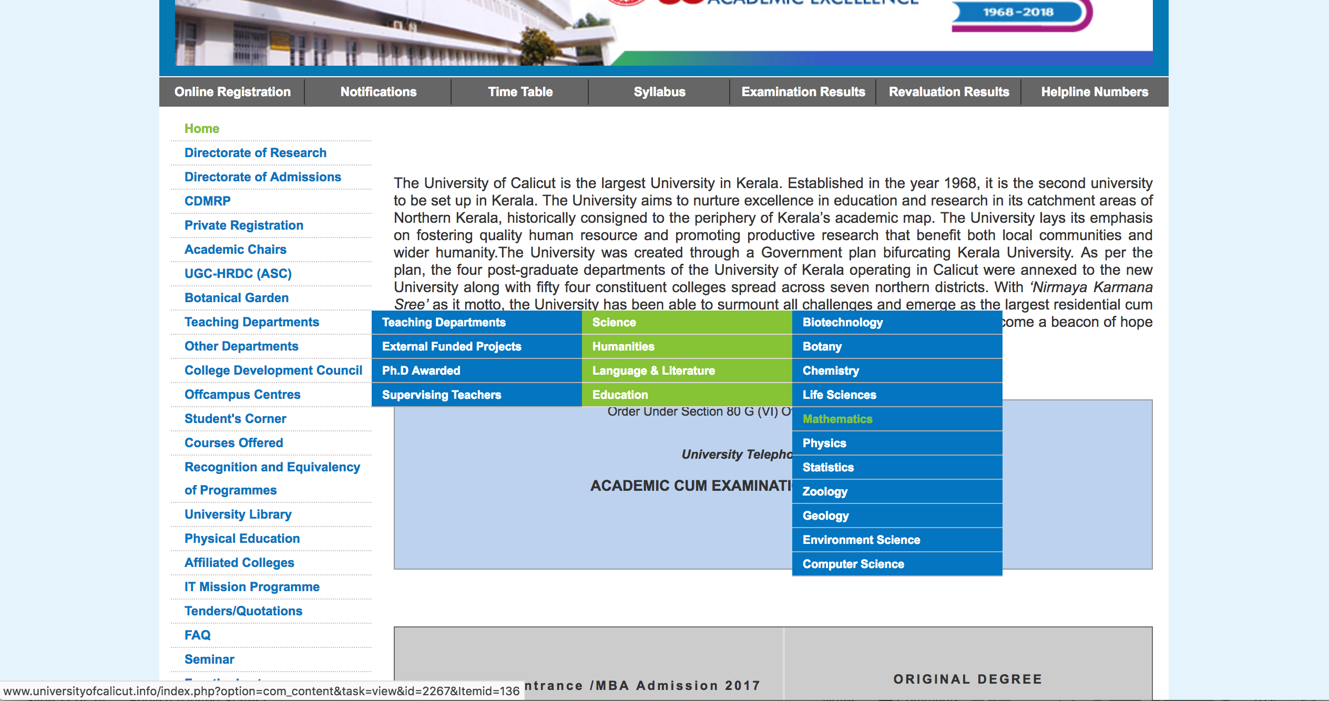
Reverse engineering wireframes
Notes:
Examples of things that shouldn’t get into production

Slide 22
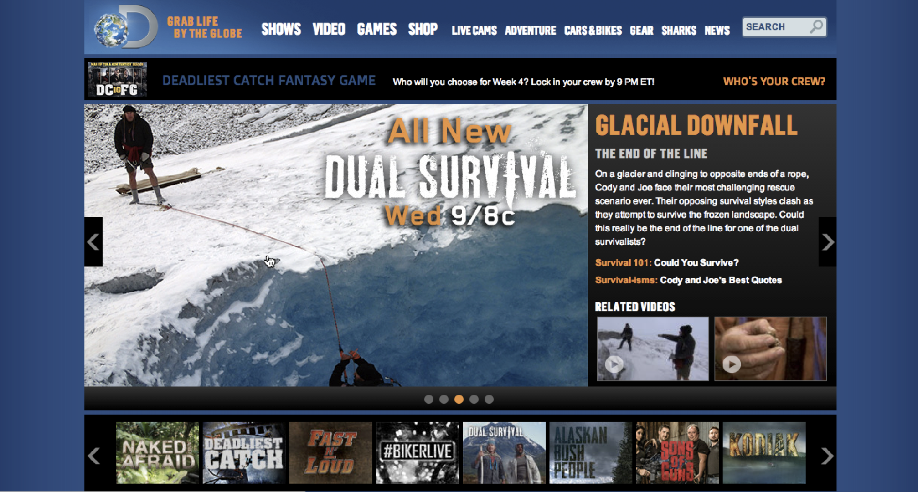

Reverse engineering wireframes
Notes:
Show animations… target sizes too small for carousel selector at bottom. Difference between blocks on right with and without play button on them… leads to missed requirements for implementation when the arrows aren’t there, but easy to miss. We also have the opportunity to use this wireframe with people that use dragon or switches to understand how they’d use this interface. That’ll help us figure out: approach to navigating/getting around the interface, and what commands people would say to use the interface with dragon.

Slide 23
An ounce of prevention
An ounce of prevention is worth a pound of cure.

Slide 24
TOP 9 THINGS to catch in wireframes
Tap/click target size
Complex interactions
Linear flow issues
Keyboard issues
Proximity related issues
Naming/labelling of controls
Complex form field labelling
Error messaging strategy
Using colour alone to convey meaning

Slide 25



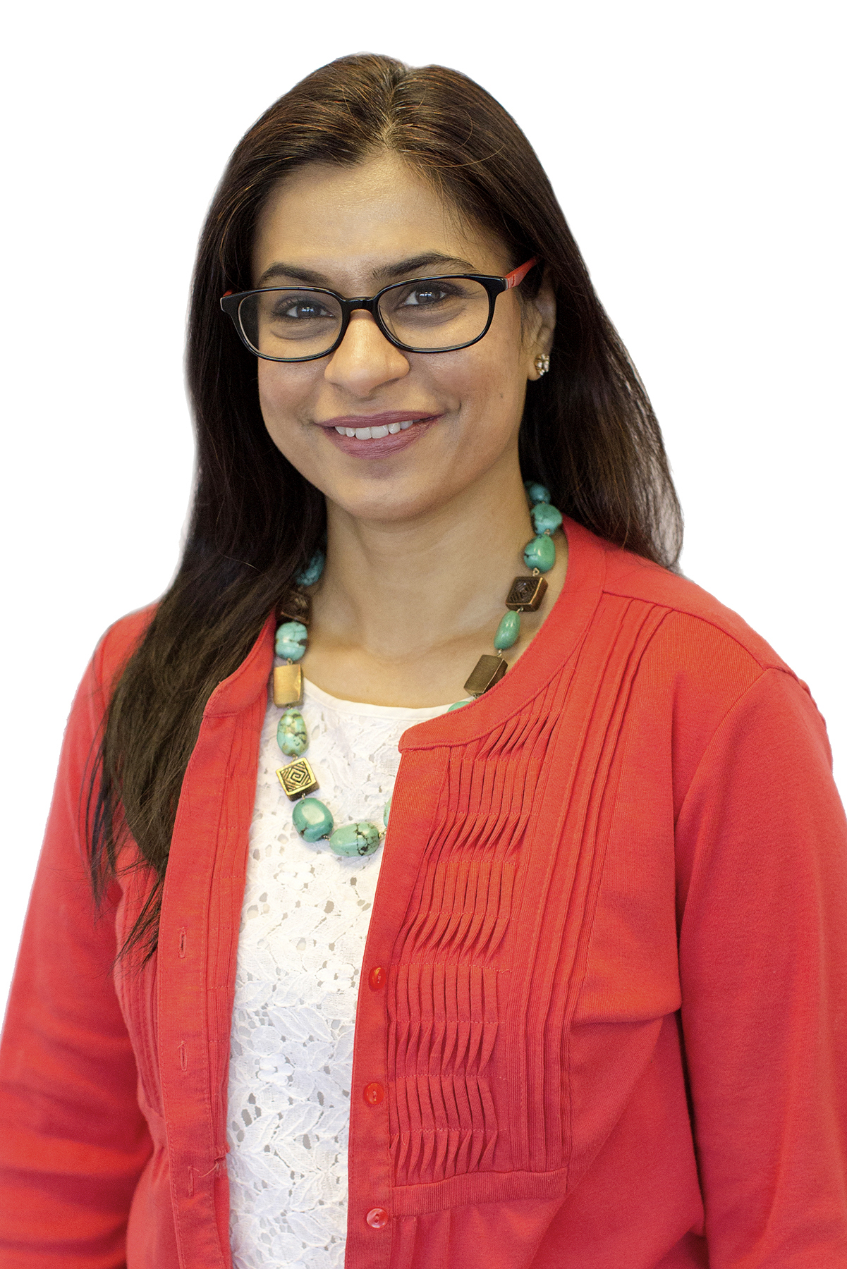


Thank You/ Resources
Accessible Cooking with the Instant Pot Using Bluetooth and iPhone Apps
Contact Us
Follow Us
@LevelAccessA11y
Level-Access
Derek Featherstone
Derek.Featherstone@LevelAccess.com
Level Access
Mona Rekhi
Mona.Rekhi@LevelAccess.com
Level Access Blog
Slide Deck Available for Download at: https://www.levelaccess.com/csun18/

